Slide 1
Movie remakes
Basic 08
Unit 12ª

Slide 2
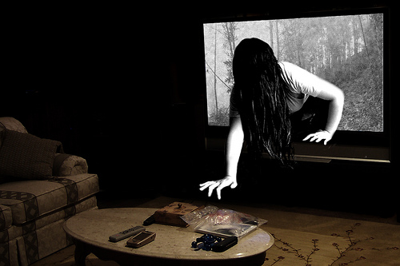
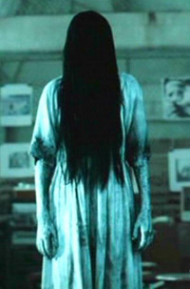
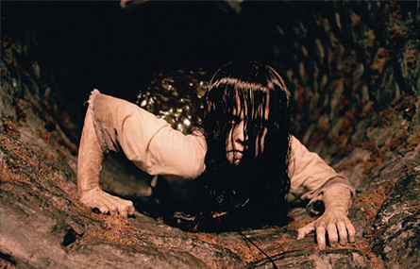
Ringu.
Do you know which movies are these scenes from?
The ring

Slide 3
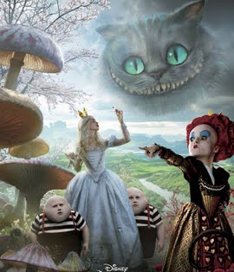
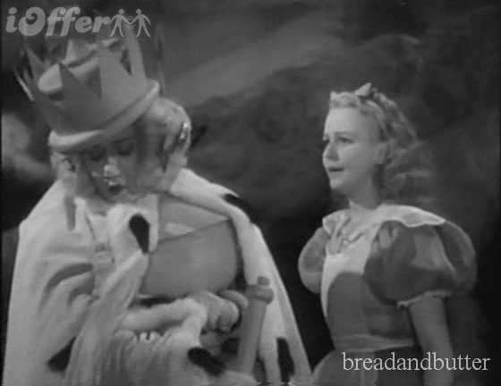
Do you know which movies are these scenes from?
Alice in wonderland

Slide 4
Movie awards
Basic 08
Unit 12ª

Slide 5

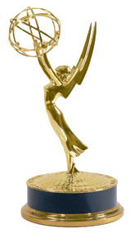
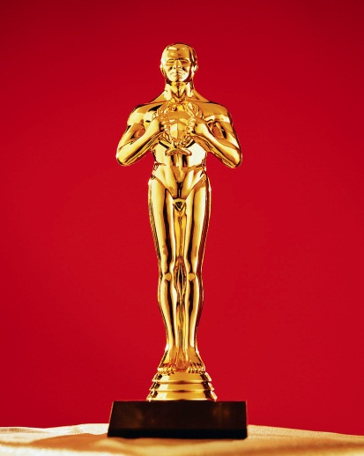
What kind of awards are these?

Slide 6
Ringu.
The ring

